Slide 1
IT8703 Applied Machine Learning - CA 1 Facebook Metrics Report
Data Analysis Prediction of Facebook Metric Total Interactions
Lum Kok Keong (P7320307)
NSDAI2 Class 2 (Thursday)

Slide 2
Agenda
Introduction
I - Exploratory data analysis
II - Feature engineering
III - Modeling
IV - Hyperparameters tuning
V - Saving the trained Model
VI - Submission of test data and results
VII - Summary

Slide 3
Introduction

Slide 4
Introduction (1/2) Reference of Facebook Metric datasets
In this assignment, a datasets dataset_Facebook.csv was selected and downloaded from Polymall. Facebook dataset has been collected from the internet Facebook's side of the renowned cosmetic brand in 2014. The dataset contained a 500 published posts in the cosmetic brand. There are 12 columns of target variables.
Problem Statement :
A renowned cosmetics brand is spending a good amount of time and efforts in various marketing platforms in order to improve its brand value which in turn hopefully be converted to sales.
The Management especially is interested in knowing about the social media promotions. The company has been posting various content on its Facebook (FB) page and wants to know how people are reacting to the marketing campaign that are taking place on that page. Company wants to analyse the efficiency of their Facebook page by using the performance metrics provided by Facebook Insights (Joss, 2012).
This should help the company to determine the factors affecting the reachability and improve the content of the page, so that the page is more effective in reaching to the customers. Thereby improving the brands visibility, this might in turn increase the profits in the due course.

Slide 5
Introduction (2/2)
There are 7 features with the following types:
Identification features (the attributes that defining each single post)
content features (represents the word-based part of the published post);
Classification features (the attributes that can describe the published post);
Performance features (the evaluation parameters that influence of the published post such as ‘Page total likes’ feature)
References resources used as follow :
http://dx.doi.org/10.1016/j.jbusres.2016.02.010
https://snap.stanford.edu/proj/socmedia-kdd/

Slide 6
Introduction Data Analysis Prediction Process
We will be using 6 different stages as follow :
Exploratory data analysis
Feature engineering
Modeling
Hyperparameters tuning
Saving the trained Model
Submission of test data and results
The scikit, csv, numpy, matplotlib, preprocessing, pickle, tree,ensemble, linear_model, model selection, metrics are used for this assignment
6 algorithms with 7 different features sets are used to evaluate the dataset:
Logistic Regression
Decision Tree Regressor
Random Forest Regressor
Lasso
Support Vector Machine
Dummy Regressor

Slide 7
I - Exploratory data analysis

Slide 8
Facebook Metric data statistics (1/14) Dataset Description

Slide 9
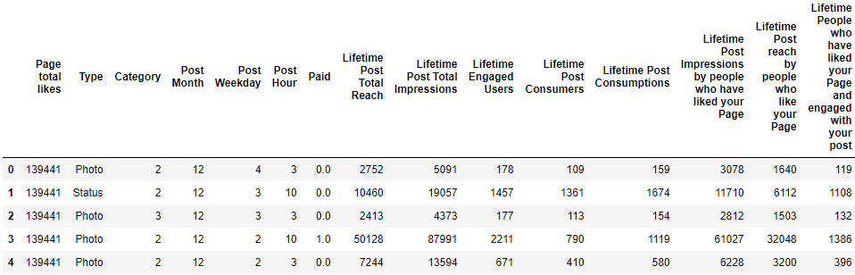
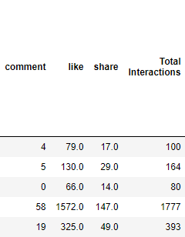
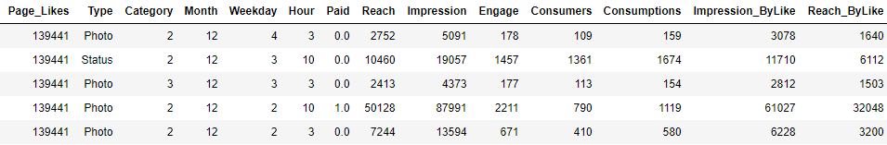
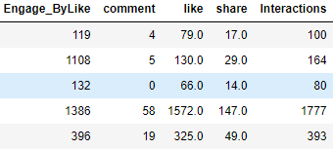
Facebook Metric data statistics (2/14) Rename of Columns names (1/2)
The Columns has been renamed from the top table to the table below

Slide 10
Facebook Metric data statistics (3/14) Rename of Columns names (2/2)

Slide 11
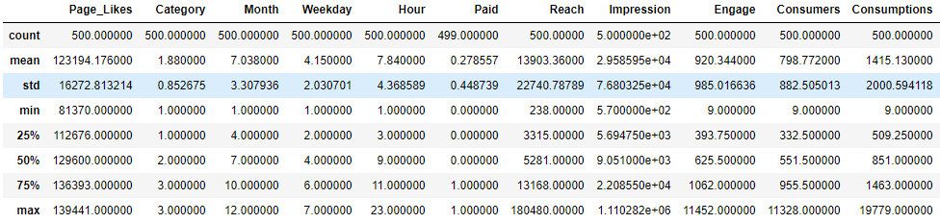
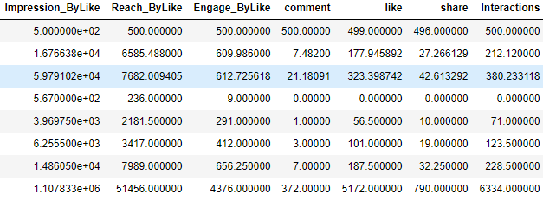
Facebook Metric data statistics (4/14) Basic Statistics using Pandas

Slide 12
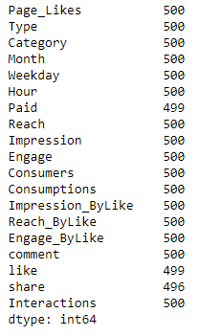
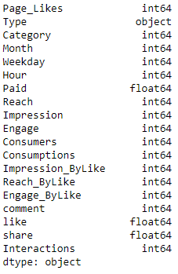
Facebook Metric data statistics (5/14) Dataset Details
For this exercise, Total Interactions is used as the target
The count variable shows that 1 value is missing in the Paid & Like columns and share has 4 missing
Since there is very few missing data, it is decided that the miss data row will be removed.

Slide 13
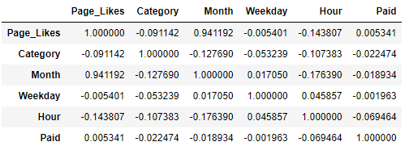
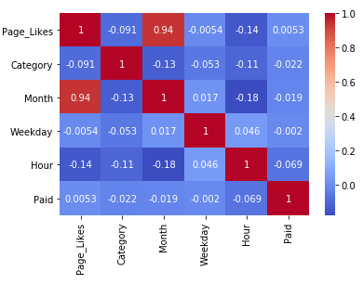
Facebook Metric data statistics (6/14) Features Correlations
Seems like Page_Likes & Month has the highest correlation.
The relevance factor also shows Type is one of the lowest due to that Page_likes shows the top influence feature

Slide 14
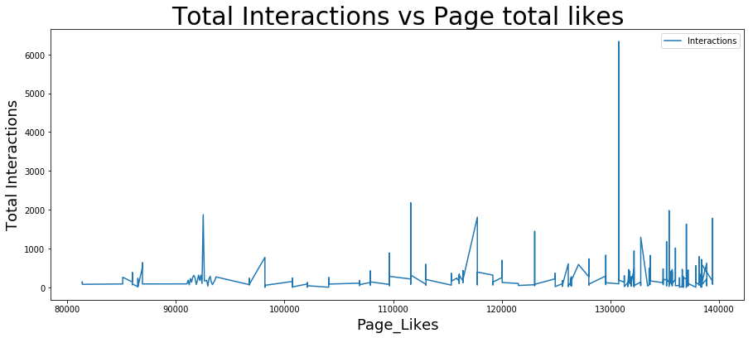
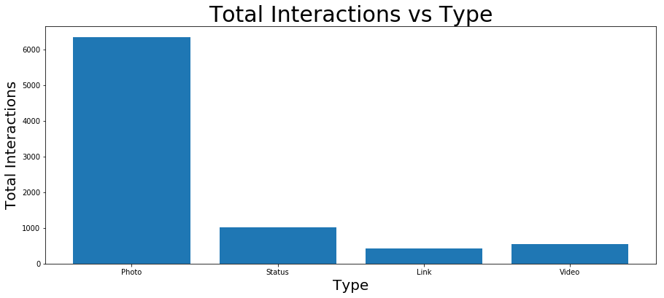

Facebook Metric data statistics (7/14) Analysing in details for feature Page_total_likes & Types
Observations:
From the bar chart it shows the ‘Photos’ Type has the highest volume influence to the Total Interactions. This shows photo posting has great effect
From the Line Chart, it shows the Impression has peaked at 6000+ in about 130000+ Page_Likes and after which drops and maintain below 3000.
Using Decision Tree Regressor algorithm shows that Page_total_likes has 33.7% relevance, the most influence features. Type has the least influence.

Slide 15
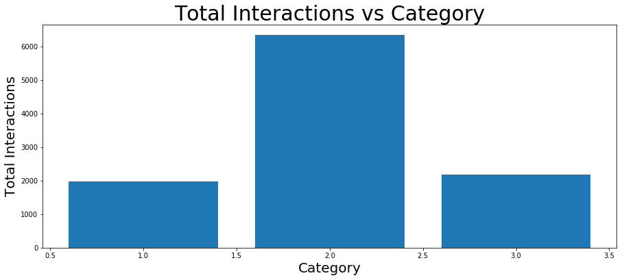

Facebook Metric data statistics (8/14) Analysing in details for feature Category
Observations:
From the bar chart it shows the Category 2 has the highest volume influence to the Total Interactions
Manual content characterization:
1 : action (special offers and contests),
2 : product (direct advertisement, explicit brand content), and
3. inspiration (non-explicit brand related content)
Only column created manually by the Facebook page managers. This categorization was a request from the company's senior marketing managers as it relates to the types of campaigns performed by this speciﬁc cosmetic company. It provides a manual categorization according to the campaign to which the content posted is associated

Slide 16
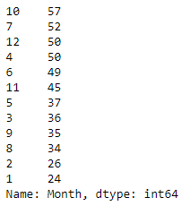
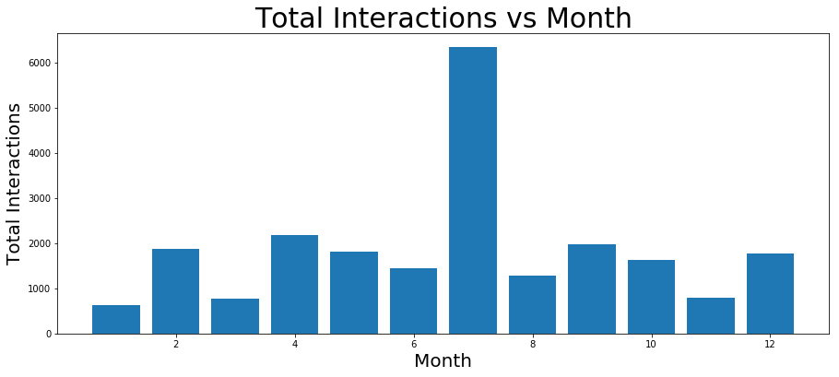
Facebook Metric data statistics (9/14) Analysing in details for feature Month
Observations:
From the bar chart it shows the July has the highest volume influence to the Total Interactions with peak above 6000+
The pattern suggests there must be some activities in July as the rest of the year seems running at an average 1500-2000 interactions

Slide 17
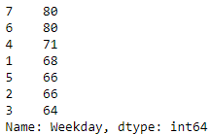
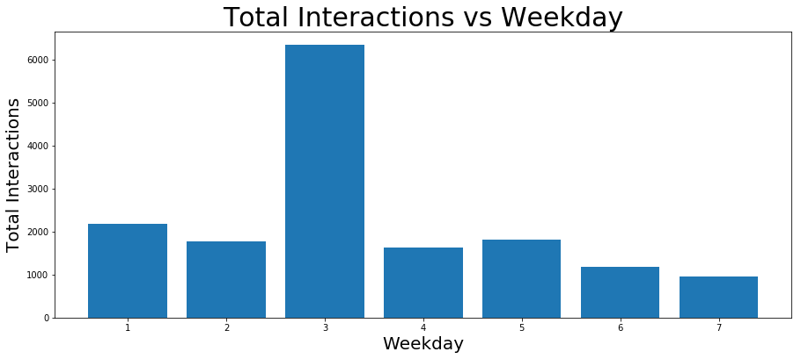
Facebook Metric data statistics (10/14) Analysing in details for feature Weekday
Observations:
From the bar chart it shows the Tuesday has the highest volume influence to the Total Interactions with peak above 6000+
Using Decision Tree Regressor algorithm shows that Weekday has 17.2% relevance, the second most influence features.

Slide 18
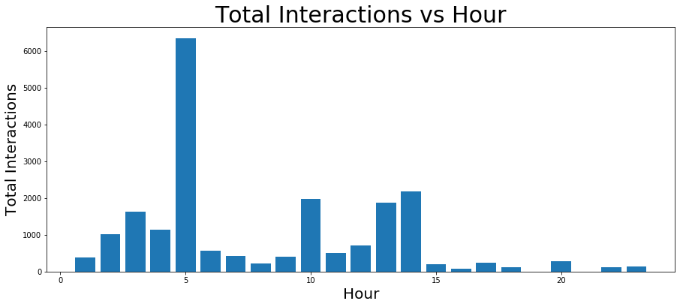
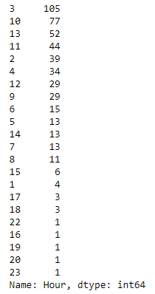
Facebook Metric data statistics (11/14) Analysing in details for feature Hour
Observations:
From the bar chart it shows the 5am has the highest volume influence to the Total Interactions with peak above 6000+
Using Decision Tree Regressor algorithm shows that Hour has 16.4% relevance, the third most influence features.

Slide 19

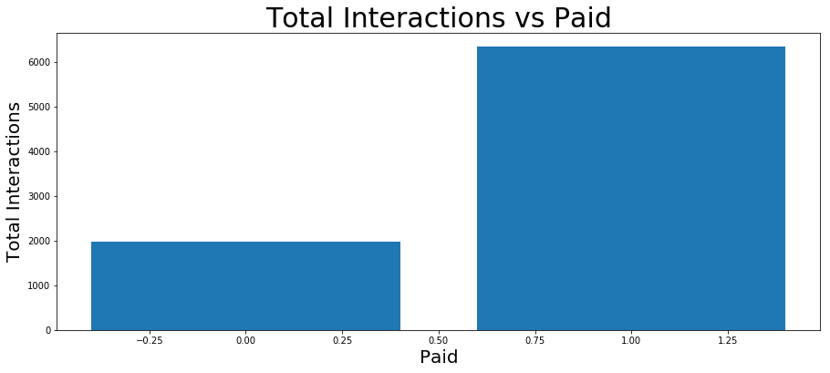
Facebook Metric data statistics (12/14) Analysing in details for feature Paid
Observations:
From the bar chart it shows the Paid has the highest volume influence to the Total Interactions with peak above 6000+
A post for which the company paid for advertising has a more impact than a post not paid
Using Decision Tree Regressor algorithm shows that Paid has some significant fifth relevance at 10.7%.

Slide 20
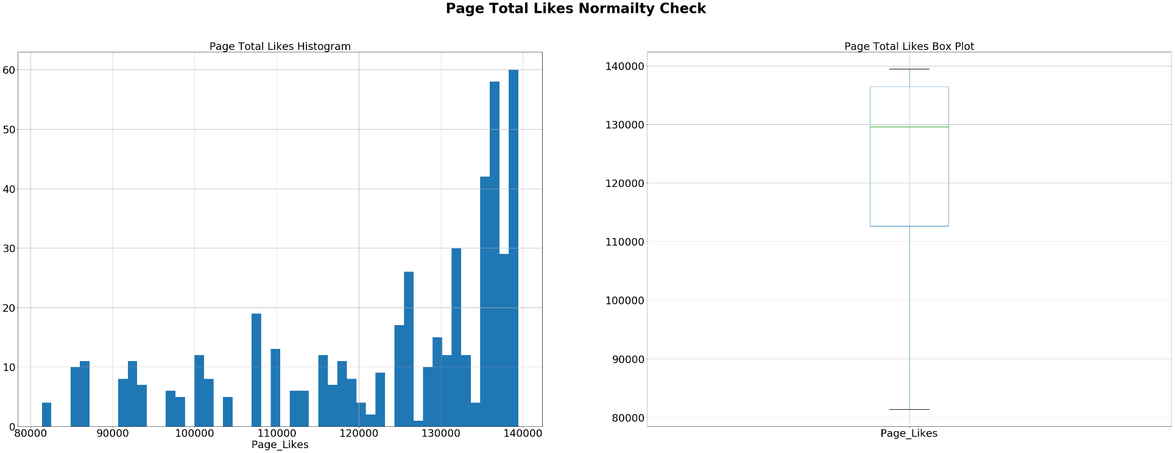
Facebook Metric train data statistics (13/14) Checking on Page_total_likes Normality Check (1/2)
Observations:
Both the histogram & box plot shows that the data is skew to the right

Slide 21
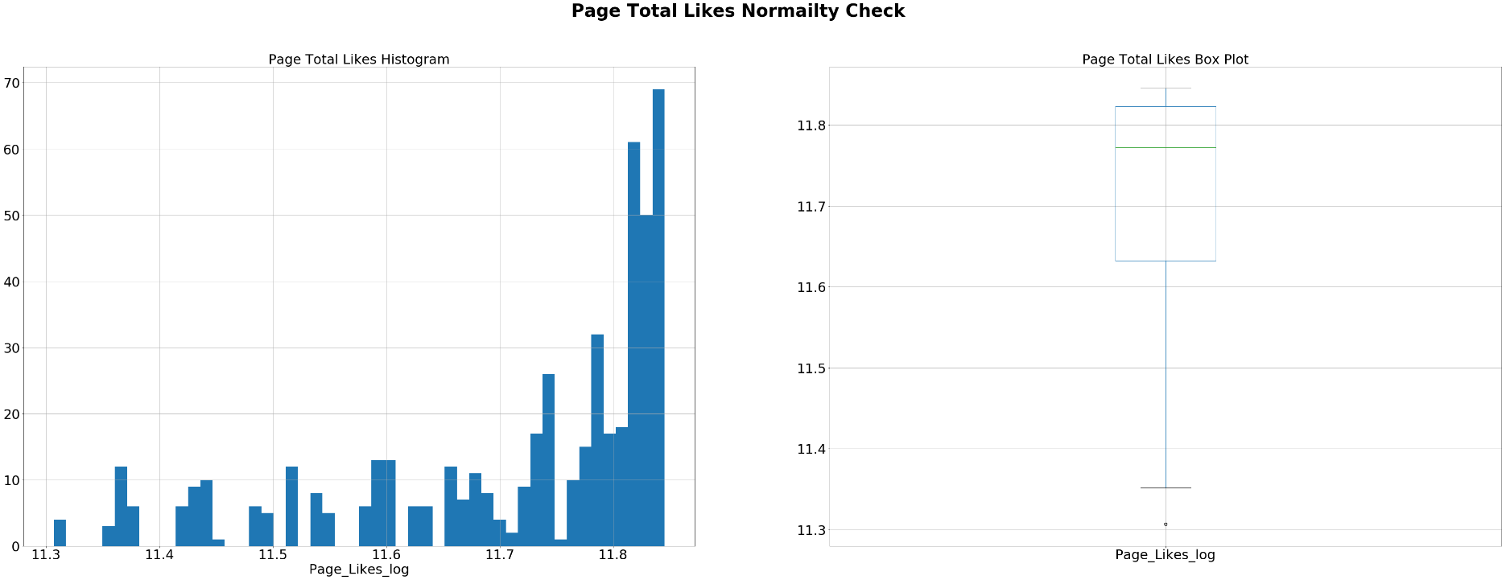
Facebook Metric train data statistics (14/14) Checking on Page_total_likes Normality Check (2/2)
Observations:
After using Logarithm method to normalised the data, both the histogram & box plot shows that the data is still skew to the right.

Slide 22
II - Feature engineering

Slide 23
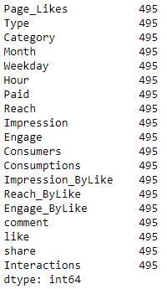
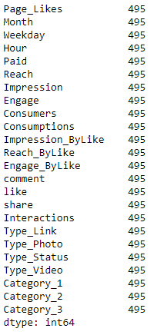
Feature Engineering (1/2) Processing missing Data
1 value is missing in the Paid & Like columns and share has 4 missing Embarked variable has missing 2 values. This is a small number. Simply replacing them with the mode age
Since there is very few missing data, it is decided that the miss data row will be removed
Type and Category columns will be using the get_dummy function to label encode since they are the category data type
Final Features to be used for the prediction test
After removing missing data rows

Slide 24
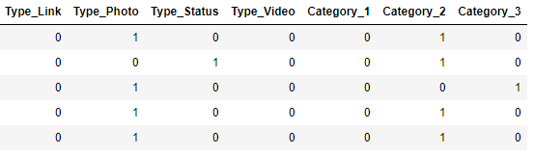
Feature Engineering (2/2) Label encoding for category data
Since, sklearn requires all inputs to be numeric, we should convert all our categorical variables into numeric by encoding the categories.

Slide 25
II - Modeling

Slide 26
Modeling (1/8) Importing the require modules for the modeling
Next, we will import the required modules. Then we will define a generic classification function, which takes a model as input and determines the Accuracy and Cross-Validation scores.
Import models from scikit learn module:
from sklearn.linear_model import LinearRegression, Lasso
from sklearn.svm import SVC
from sklearn.model_selection import KFold #For K-fold cross validation
from sklearn.tree import DecisionTreeRegressor, export_graphviz
from sklearn.ensemble.gradient_boosting import GradientBoostingClassifier
from sklearn.ensemble import RandomForestRegressor
from sklearn.dummy import DummyRegressor
from sklearn import metrics

Slide 27
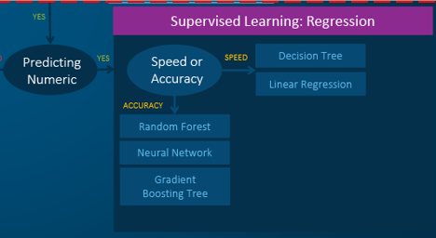
Modeling (2/8) Algorithm Selection

Slide 28
Modeling (3/8) Testing of features selection
Four set of different number of features will used for the test on all the 5 algorithms
['Page_Likes', 'Month', 'Weekday', 'Hour', 'Paid', 'Type’, 'Category']
['Page_Likes', 'Month', 'Weekday', 'Hour', 'Paid', 'Type’]
['Page_Likes', 'Month', 'Weekday', 'Hour', 'Paid']
['Page_Likes', 'Month', 'Weekday', 'Hour'] – Selected as the best results
These sets are selected is due to that for the 7 features test results shows that the top 4 features weightage are the 'Page_Likes', 'Month', 'Weekday', 'Hour'. This set of test is to see if the other 3 is redundant. Results shows that the top 4 yield lower results than the top 5 & 6 and the Top 6 features yield the highest results.
Dummy Regressor is used as the baseline for comparison
3 different algorithm are used for comparison to see which can offer the best perofmance results as follow:
Logistic Regression
Random Forest Regressor
Decision Tree Regressor
Lasso
Support Vector Machine
From the test result in the next slide, it shows that Decision TreeRegressor using the top 6 features has the most suitable scores, hence it is selected as the final algorithm for the prediction
A 10-fold cross-validation using Kfold test harness is used to demonstrate each metric

Slide 29
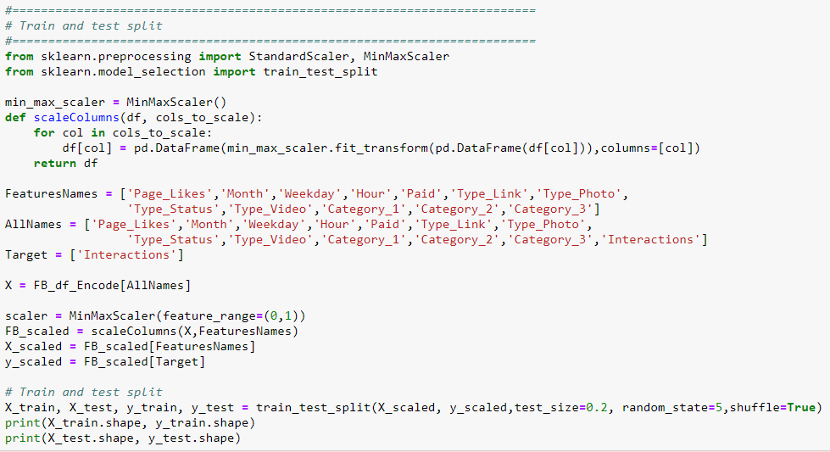
Modeling (4/8) Train & Test and Scaling using MinMaxScaler

Slide 30
Modeling (5/8) Testing results (1/2)

Slide 31
Modeling (6/8) Testing results (2/2)

Slide 32
Modeling (5/6) Selecting the Algorithm (1/2)
The Mean Absolute Error (or MAE) is the sum of the absolute differences between predictions and actual values. It gives an idea of how wrong the predictions were. The measure gives an idea of the magnitude of the error, but no idea of the direction (e.g. over or under predicting).
The Error metric provides an indication of the goodness of fit of a set of predictions to the actual values.
Using MaxMinScaler to scale the Dataset, has yield very little improvement with the same set of features

Slide 33
Modeling (6/6) Selecting the Algorithm (2/2)
Generally both Lasso & SVC RBF algorithm has share the high score compare to the rest, especially for Lasso.
Mean Absolute Error or MAE – Lasso is better than SVC RBF.
After decided on using Lasso, the top 3 to 6 features testing is tested and the Top 4 features yield the highest results.
In conclusion Lasso is selected and next stage will progress to the section that describes in details in the hyper parameter tuning section
Using the Dummy Classifier as reference, the final selection of Lasso has quite a margin performance. Base on all the Performance metric results attained, I am confidence it will yield high probability of prediction

Slide 34
IV - Hyperparameters tuning

Slide 35
Hyperparameters tuning (1/5) Decision Tree Classifier parameters
from sklearn.model_selection import GridSearchCV
#metrics.SCORERS.keys() - check scoring options
#Define the alpha values to test
alpha_lasso = [1e-15, 1e-10, 1e-8, 1e-5,1e-4, 1e-3,1e-2, 1, 5, 10]
parameter_grid = {
'alpha': alpha_lasso,
'normalize': [True],
}
cross_validation = KFold(n_splits=10, shuffle=True,random_state=None)
grid_search = GridSearchCV(Lasso(normalize=True),
scoring='neg_mean_absolute_error',
param_grid=parameter_grid,
cv=cross_validation,
verbose=1,
n_jobs=-1
)
grid_search.fit(X_train_4,y_train_4)
model = grid_search
parameters = grid_search.best_params_
As reference to the Modeling test results that Lasso with all the 4 features shows the best highest performance, hence we will be using a Lasso model for the Hyperparameters tuning
Importing using the following modules for the tuning :
from sklearn.model_selection import GridSearchCV
With GridSearchCV, we can specify a grid of any number of parameters and parameter values to traverse. It will train the classifier for each combination and obtain a cross-validation accuracy to evaluate each one.

Slide 36
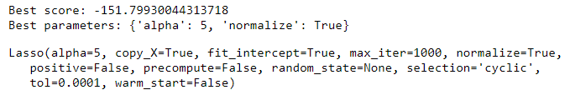
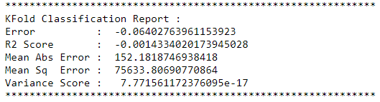
Hyperparameters tuning (2/5) GridSearchGV results
Observations:
As reference to the previous default Lasso test results , it has achieved higher than the GridSearchCV test results, hence it is decided to use the default parameters instead

Slide 37
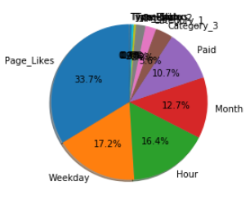
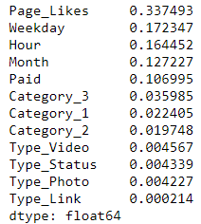
Hyperparameters tuning (3/5) Features Importance (1/3)
Observations:
After the fine tuning the features importance weightage is as shownreference to the Decision Tree Regressor using the default parameters.

Slide 38
Hyperparameters tuning (4/5) Features Importance (2/3)
Observations:
Generally, comparing to the algorithms tested, all share the same top 4 features weightage as follows:
Page_Like
Weekday
Hour
Month

Slide 39
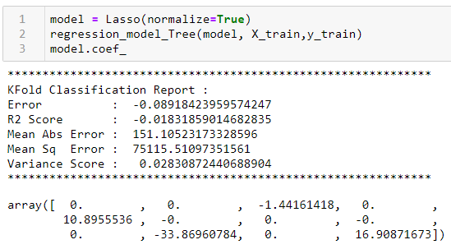
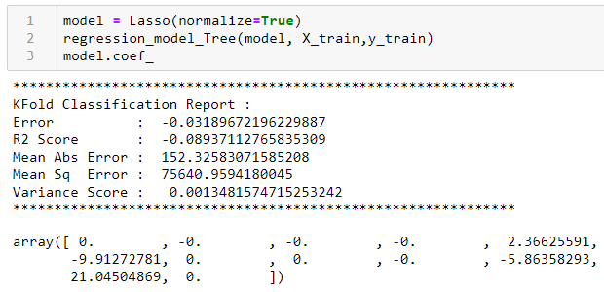
Hyperparameters tuning (5/5) Features Importance (3/3)
Without Scaling
An important characteristic of Lasso Regression is that it tends to completely eliminate the weights of the least important features (i.e., set them to zero).
Page_likes, Month, Hour, Type_Link, Type_Photo, Type_Status, Type_Video & Category_2 are 0 without scaling the dataset
Page_likes, Month, Weekday, Hour, Type_Photo, Type_Status, Type_Video & Category_3 are 0 with scaling the dataset
With Scaling
FeaturesNames = ['Page_Likes', 'Month', 'Weekday', 'Hour', 'Paid', 'Type_Link', 'Type_Photo', 'Type_Status', 'Type_Video', 'Category_1', 'Category_2', 'Category_3']

Slide 40
V - Saving the trained Model

Slide 41
Saving the trained Model Saved the model using pickle & Visualising of the tree
# We can save the trained model clf using pickle
import pickle
model = model = Lasso(normalize=True)
regression_model_Tree(model, X_test,y_test)
s = pickle.dumps(model)
pickle.dump(model, open( "FB_Interactions_trained_model.p", "wb" ) )
#model2 = pickle.load( open( "Titanic_trained_model.p", "rb" ) )
# Alternatively, we can save the trained model clf with sklearn joblib
from sklearn.externals import joblib
joblib.dump(model, 'FB_Interactions_trained_model.pkl')
#model3 = joblib.load('Titanic_trained_model.pkl')

Slide 42
VI - Submission of test data and results

Slide 43
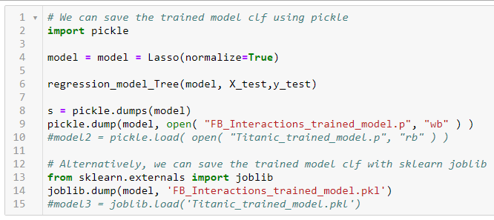
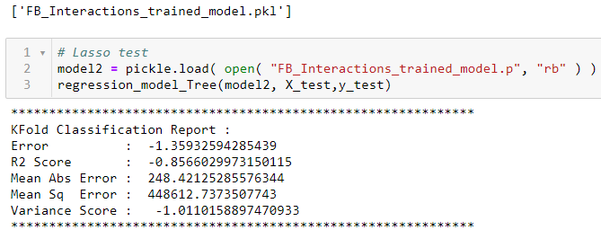
Submission of test data and results Simple Text Based analysis using Pandas

Slide 44
Summary
In the Total Interactions, Photos type has the highest volume influence but Type has the lowest influence features while Page-total_likes the highest 33.7% relevance
It also has the highest category 2, Product (direct advertisement, explicit brand content) volume influence. Month shows the July has the highest volume influence and has the 4th most influence weightage at 12.7%
Weekday has the second highest relevance at 17.2% showing Tuesday the highest volume
Hour has shows the third most influence feature at 16.4% at 5am sowing the peak
The Paid has more Interactions than the not paid which means paid has more impact but Paid feature is the fifth most influence weightage at 10.7% weightage
Hence in conclusion that paying for the speciﬁc post to boost the reachability for Total Interactions and focusing on publishing on the right month Weekday may helps. And using Photos with focus on more direct advertisement, explicit brand content may helps to improve the Total Interactions.
So from the combination results of Total Interactions and Impression, it shows that Total_page_likes is one of the major influence features which is the Number of people who have liked the company's page. Focusing on Photos and direct advertisement (Paid), explicit brand content with Special offers & contest on the right Month and Weekday will boost the and improve its brand values and may which in turn be converted to more sales

Slide 45
Thank You

